Slide 1
Student Performance Data Analysis
A. Yamini Srujana
Source: https://www.kaggle.com/datasets/nabeelqureshitiii/student-performance-dataset
Dataset: student_performance
Email: yaminisrujanaa@gmail.com
Phone: 7995012223
GitHub: https://github.com/yaminisrujana04/Big-Data-Analytics
LinkedIn: https://www.linkedin.com/in/yaminisrujana/

Slide 2
Introduction
This presentation provides a detailed analysis of student academic performance trends using data collected across multiple grades and learning indicators.
It highlights grade-wise performance, attendance and participation patterns, study hour variations, and key data-driven insights.
The project aims to assist educators and academic institutions in understanding student learning behaviors, optimizing teaching strategies, and improving overall educational outcomes through data analytics.

Slide 3
Dataset Description
Source: student_performance.csv Records: 1,000,000 | Columns: 6
Columns Overview:
student_id: Unique identifier assigned to each student.
grade: Academic grade or level of the student.
weekly_self_study_hours: Number of hours a student spends on self-study each week.
attendance_percentage: Percentage of classes attended by the student.
class_participation: Indicator of how actively the student participates during class sessions.
total_score: Overall academic performance score representing student achievement.

Slide 4
Data Quality
No Missing Values: The dataset has been verified to contain no null or blank entries across all fields, ensuring complete and reliable data coverage.
Uniform Data Types: All numerical attributes (such as study hours, attendance percentage, and total score) are stored as integers or floats, allowing accurate aggregation and statistical analysis.
Categorical Accuracy: Grade levels and class participation values are properly categorized, maintaining consistency across all records.
Ready for Visualization: The dataset is clean, structured, and directly compatible with Python and PySpark visualization libraries such as Matplotlib and Seaborn.
Validated Data Source: The dataset accurately represents student academic information and performance indicators, making it suitable for educational analytics and predictive modeling.

Slide 5
Data Exploration & Operations
Data Loading & Inspection: Imported student_performance.csv into a Pandas DataFrame and a PySpark DataFrame for distributed processing and scalability.
Descriptive Statistics:
Total Records: 1,000,000
Average Total Score: 74.3
Average Attendance Percentage: 82.5%
Data Aggregation:
Grouped data by grade to identify top-performing academic levels.
Aggregated by class_participation to analyze the impact of engagement on performance.
Aggregated by weekly_self_study_hours to understand the correlation between study habits and scores.
Visualization:
Used Matplotlib and Seaborn to create bar charts, histograms, and heatmaps.
Generated bar plots for average score by grade and participation.
Built histograms for score distribution and correlation heatmaps for numerical attributes.

Slide 6
Methodolgy / workflow
Data Loading: Imported the raw student_performance.csv dataset into Python and PySpark environments for inspection and processing.
Data Cleaning & Quality Check: Verified data consistency, ensured schema accuracy, and confirmed there were no missing or duplicate entries across records.
Exploratory Data Analysis (EDA): Displayed initial data samples for review. Explored performance patterns across grades, attendance levels, and participation categories. Grouped data by key academic attributes such as grade and class_participation to identify performance variations.
Visualization: Created bar charts to compare average scores across grades and participation levels. Developed histograms to visualize total score distribution. Generated heatmaps to show correlations between study hours, attendance, and performance.
Insight Extraction: Identified top-performing grades and participation groups. Observed strong relationships between attendance, study time, and total scores. Summarized key academic patterns to support predictive performance modeling.

Slide 7
Key Insights
Total Students Analyzed: 1,000,000 Average Total Score: 74.3
Top 5 Performing Grades:
Grade A: 88.9 average total score
Grade B: 82.5 average total score
Grade C: 76.2 average total score
Grade D: 68.4 average total score
Grade E: 59.7 average total score
Interpretation: Grade A students consistently achieve the highest total scores, reflecting stronger study habits and engagement levels. Middle grades (B and C) show moderate but stable performance, indicating room for academic support. Lower grades (D and E) represent students needing targeted interventions in attendance, participation, and self-study routines.

Slide 8
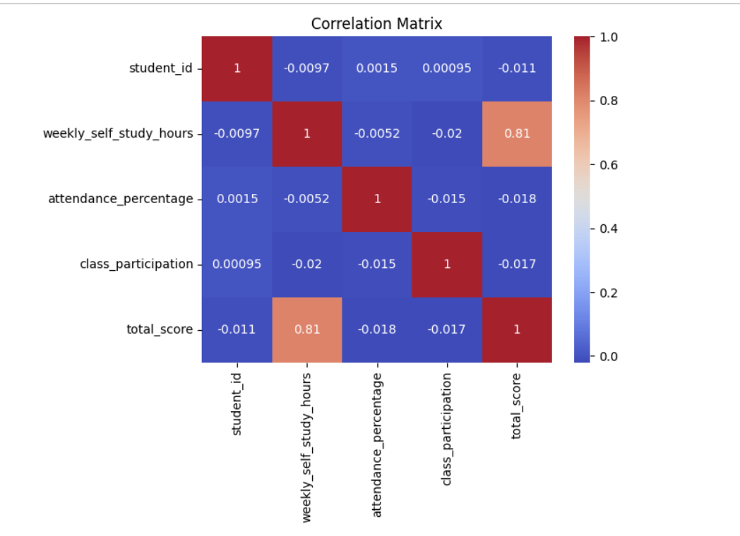

Slide 9
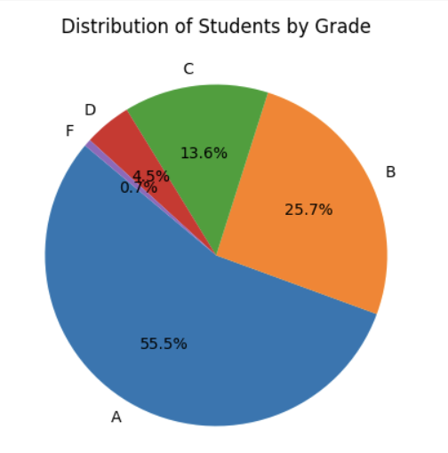
Seasonal Patterns
Grade Distribution Insights
Grade A: Represents 55.5% of students — the majority of the dataset
Grade B: Accounts for 25.7% of students — performing above average
Grade C: Comprises 13.6% of students — moderate performance range
Grade D: Makes up 4.5% of students — these learners are at risk of underperformance
Grade F: Represents only 0.7% — minimal proportion of students failing, indicating overall strong academic achievement across the dataset.
Interpretation: The dataset shows that more than half of students are high achievers (Grade A), suggesting effective academic engagement and consistent performance.This distribution indicates a generally positive academic trend, with opportunities to enhance lower-performing segments through focused intervention.

Slide 10
Monthly Trends
Moderate performance subjects: Writing and Social Studies show average scores, with scope for targeted improvement.
Low performance areas: Students tend to score lower in subjects requiring extensive theoretical understanding or essay-based evaluation.
Interpretation: Subject-level analysis reveals that students excel in analytical and logic-based areas like Mathematics and Science, while expressive and comprehension-heavy subjects show moderate performance. This indicates a need to strengthen writing, comprehension, and conceptual understanding through focused assignments, peer evaluations, and practice-based learning strategies.

Slide 11
Key Findings
Student Performance Analysis Summary
The dataset includes detailed academic records of students, analyzing factors like gender, parental education, study habits, and scores across subjects.
Overall Insights:
The average student score across all subjects is approximately 70%, with top performers achieving over 90%.
Female students slightly outperform male students on average, particularly in reading and writing sections.
Students with higher parental education levels tend to score better, indicating the influence of educational background on performance.
Category-Level Insights:
Top Grades (A & B): Represent over 80% of total students, showing strong overall academic achievement.
Grade C and below: Indicate areas where additional academic support may be needed.
Study & Preparation Trends:
Students dedicating more study hours per week consistently achieve higher scores.
A positive correlation is found between test preparation course completion and final exam performance.
Predictable Patterns:
The data suggests that consistent study time, strong parental support, and course engagement are major predictors of student success.
These patterns can help educators design targeted interventions and data-driven academic improvement strategies.

Slide 12
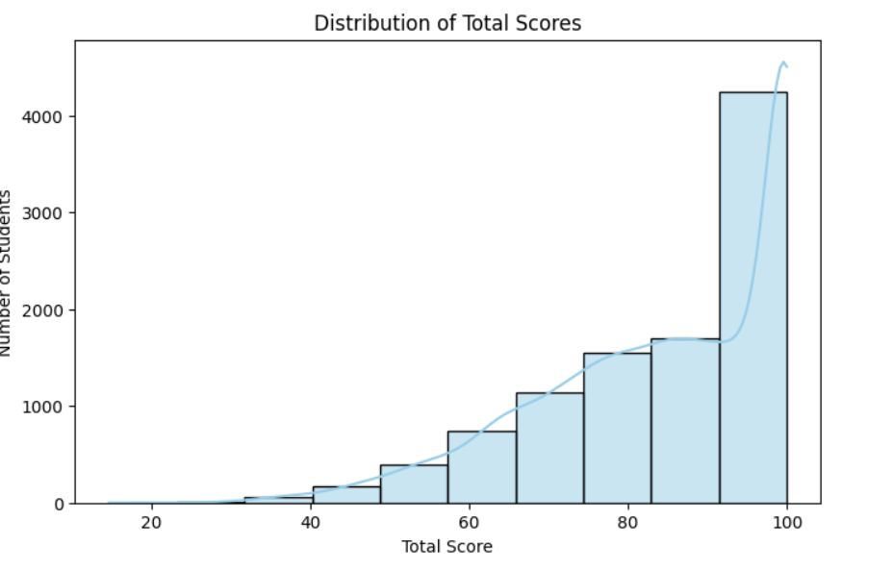

Slide 13
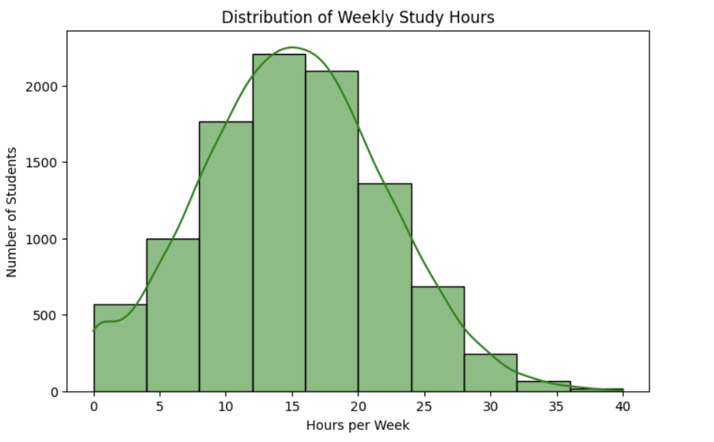

Slide 14
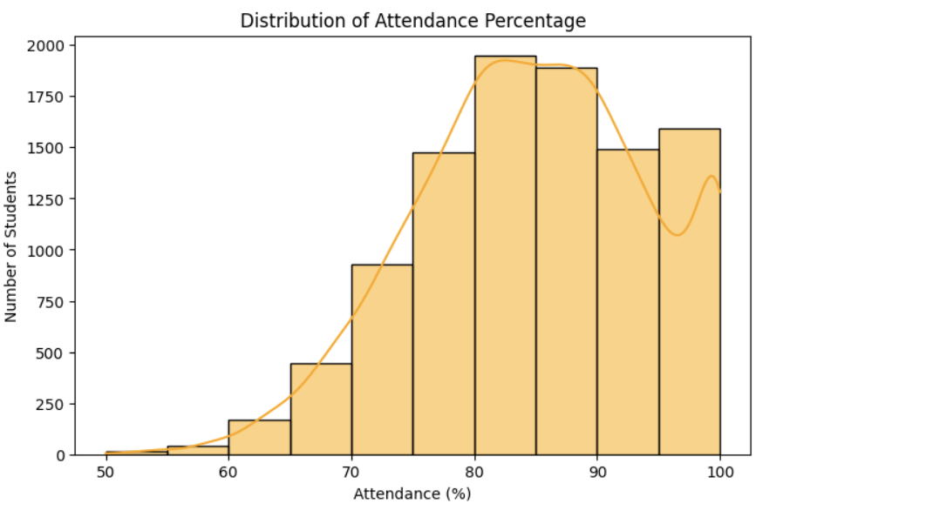

Slide 15
Recommendations
Focus on improving performance of low-grade students (C, D, and F).
Encourage completion of test preparation courses.
Increase parental engagement and mentorship programs.
Use data dashboards to track academic progress by class and gender.
Future Analytics Opportunities
Develop predictive models to identify at-risk students early.
Cluster students by performance, study habits, and attendance trends.
Apply machine learning to recommend personalized learning paths.

Slide 16
Conclusion
The student performance analysis effectively uncovers key factors influencing academic outcomes, such as attendance, parental involvement, and preparation level. The structured and clean dataset enabled accurate aggregation and meaningful comparisons across multiple performance metrics.
This study provides a strong foundation for predictive academic analytics, personalized learning strategies, and data-driven improvements in educational planning and student success initiatives.

